Slide 1
Order 1

Slide 2
Break Case

Slide 3
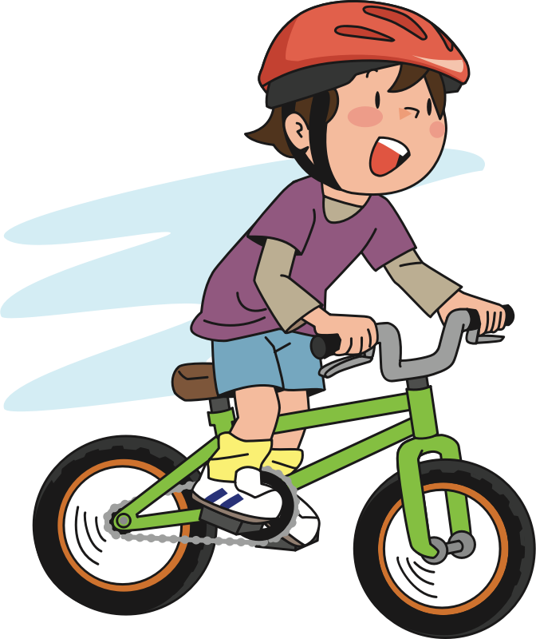
Here is Andy. He is at the park riding his bike.

Slide 4


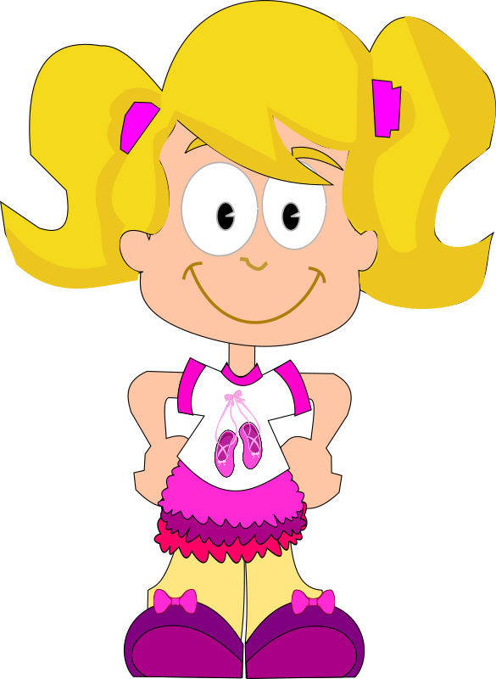
Here is Suzy. She is at the park watching butterflies.

Slide 5
Andy is riding his bike very fast and is coming around a corner.

Slide 6
As he comes around the corner, he ends up running right into Suzy! Suzy fell into the fence!

Slide 7

The fence ended up breaking! See the fence is broken!

Slide 8
Luckily nobody got hurt—Suzy and Andy were both OK.

Slide 9
Now that you saw what happened, we will ask you a couple of questions

Slide 10
Who caused the fence to break?

Slide 11
Who broke the fence?

Slide 12
Whose fault is it that the fence broke?

Slide 13
Who should get in trouble for the broken fence?

Slide 14
Crack Case

Slide 15
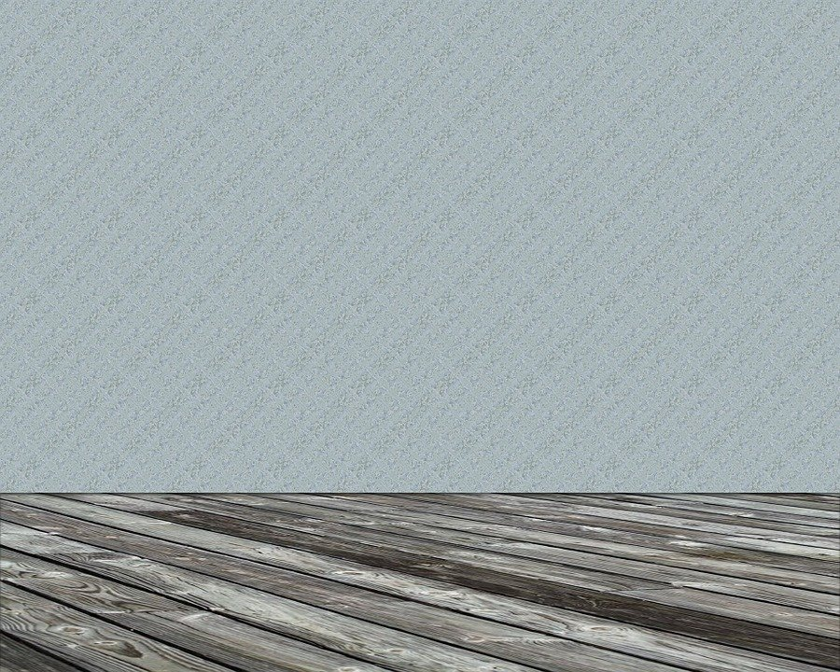
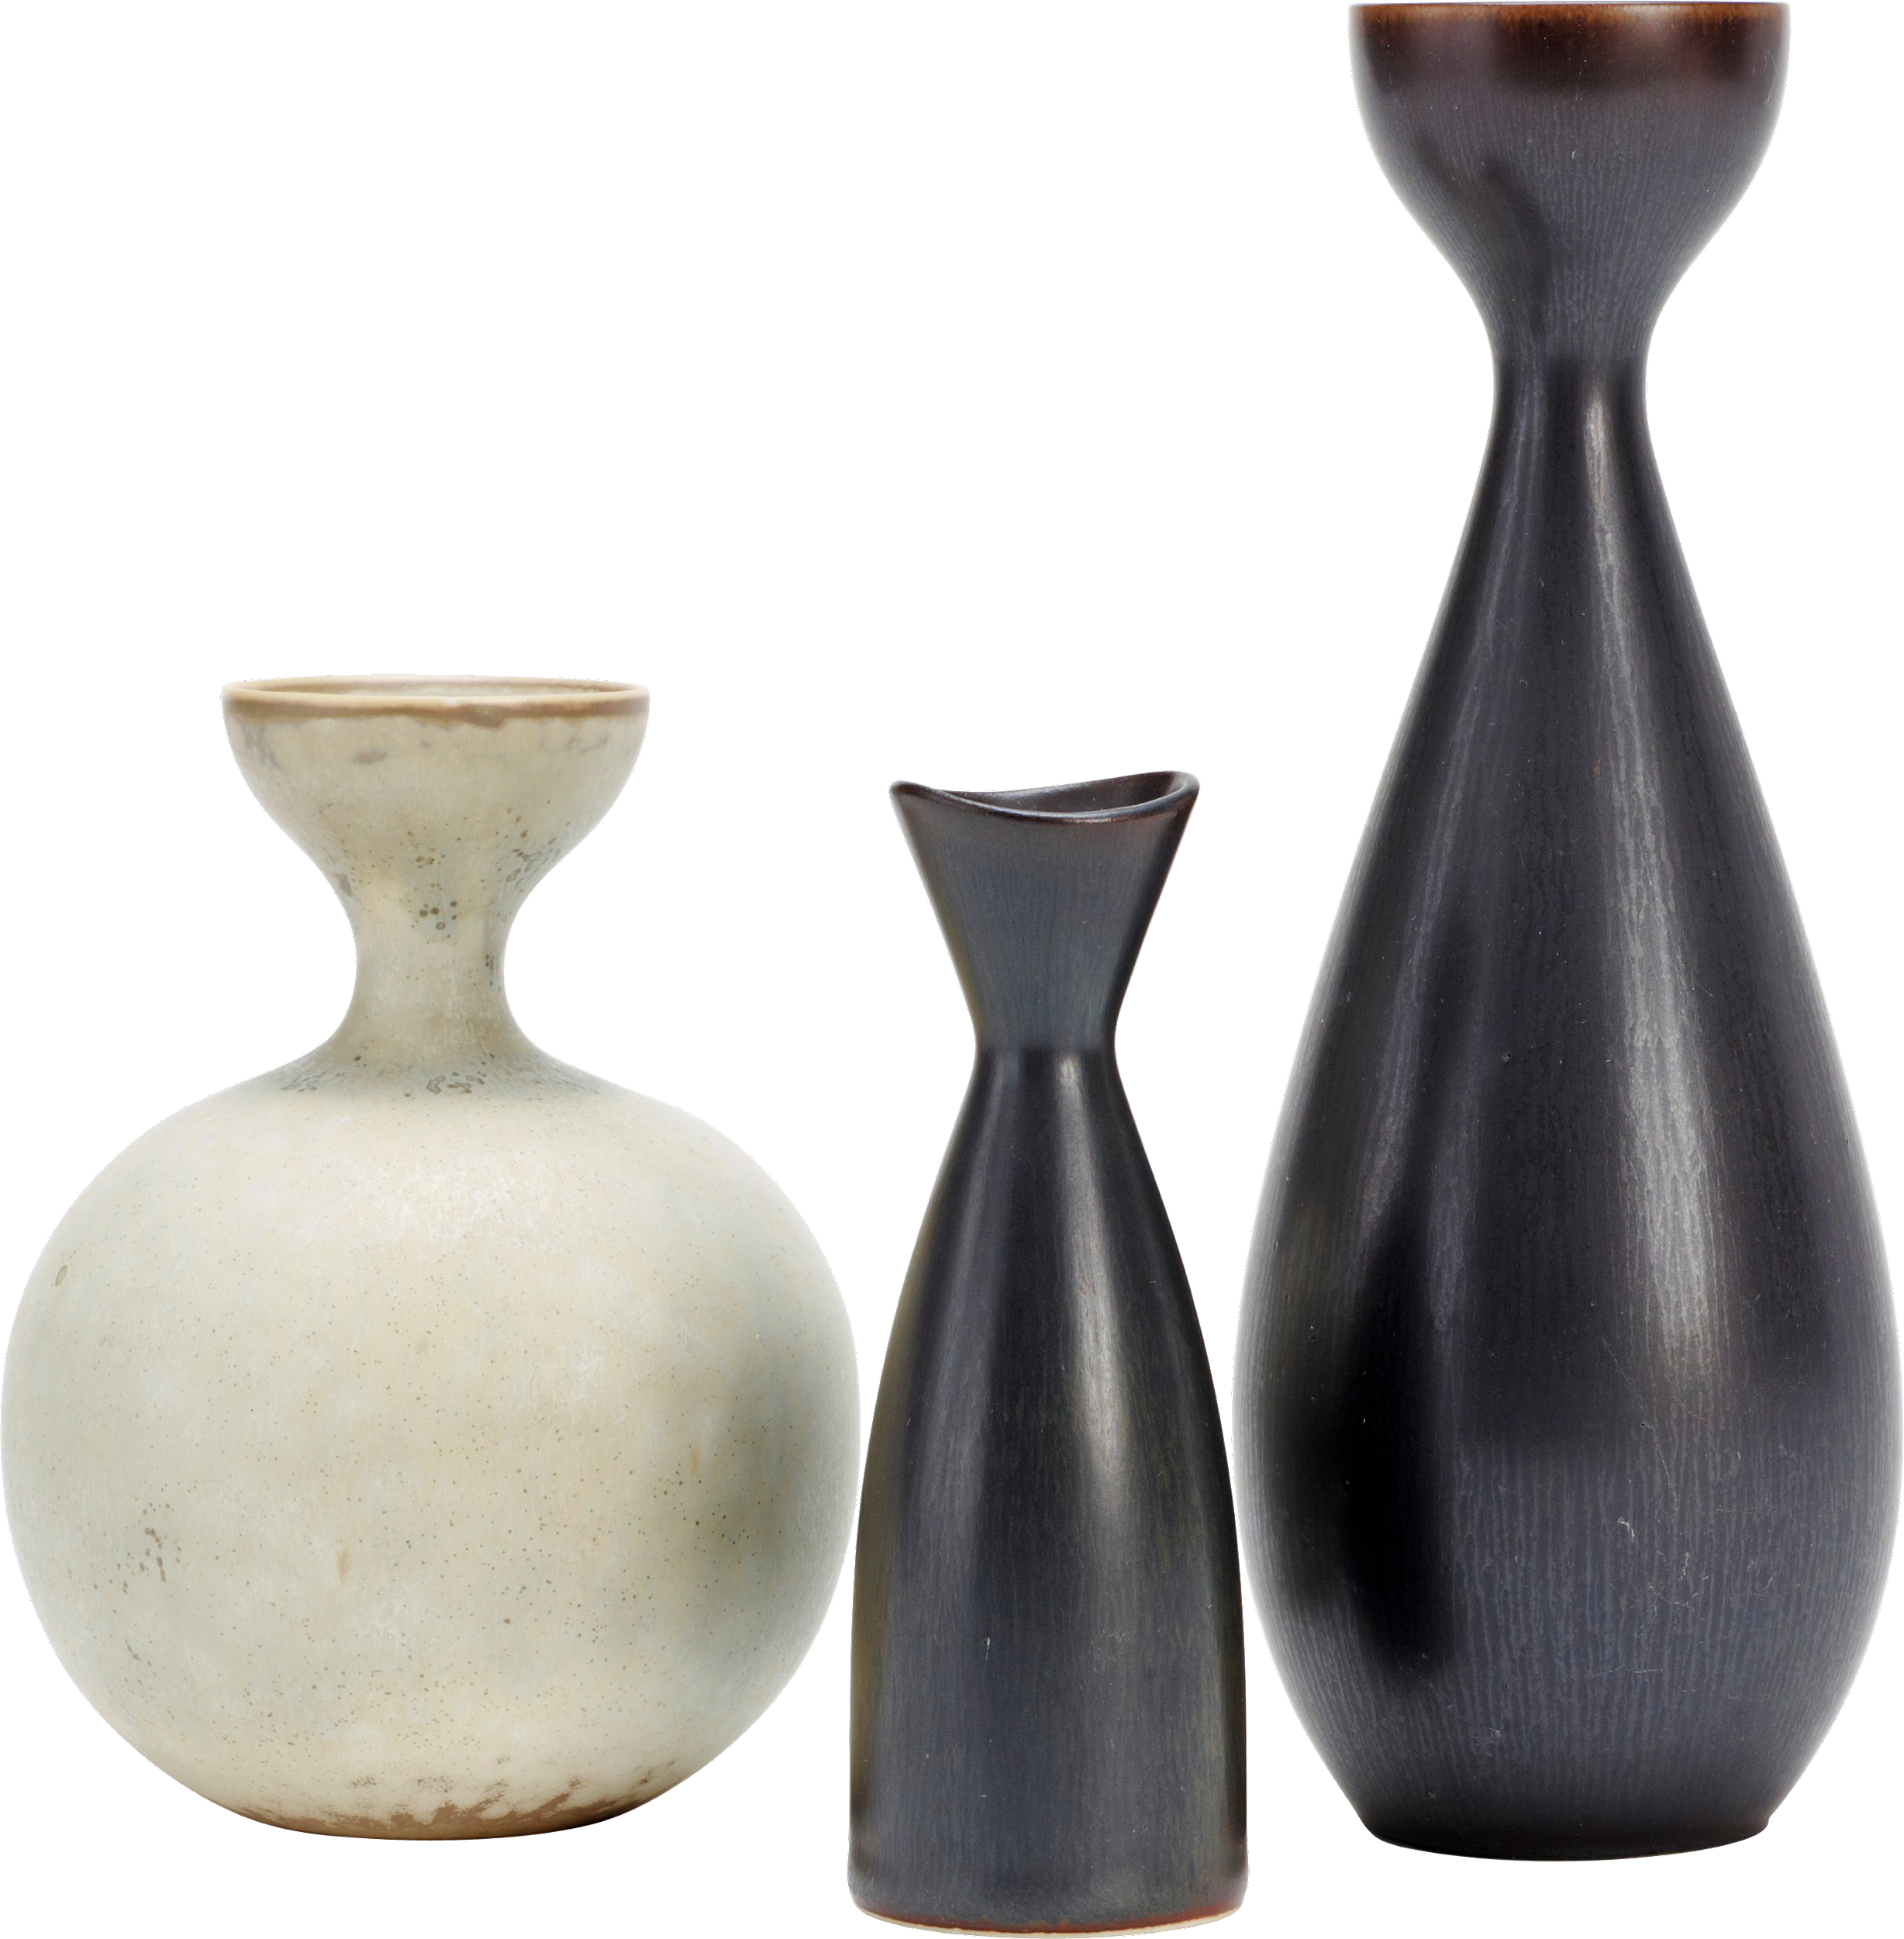

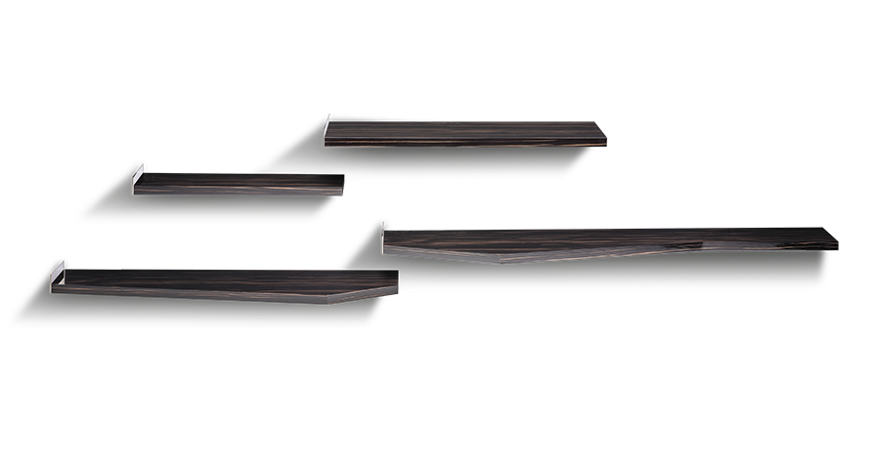
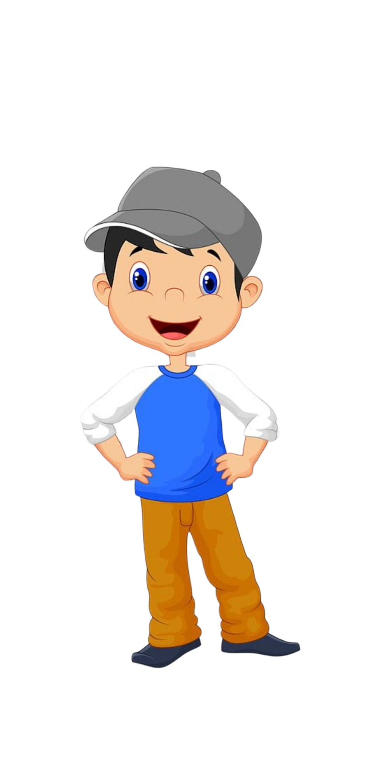





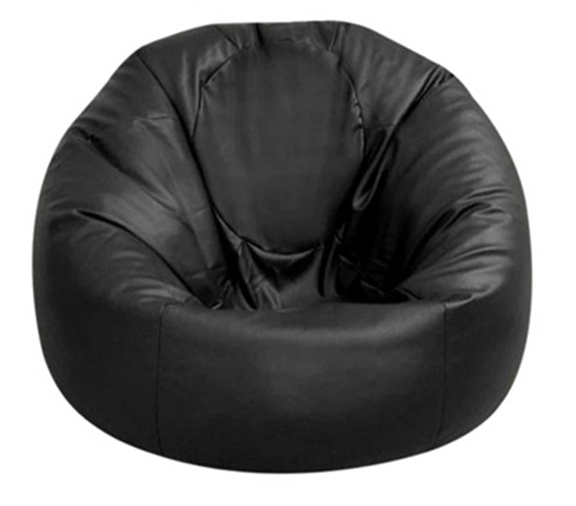
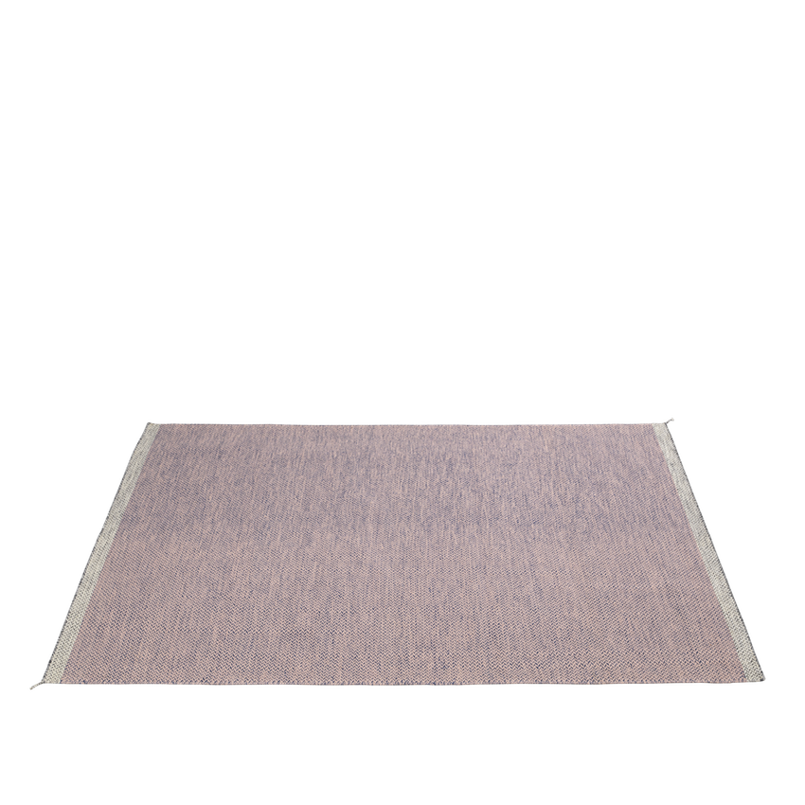

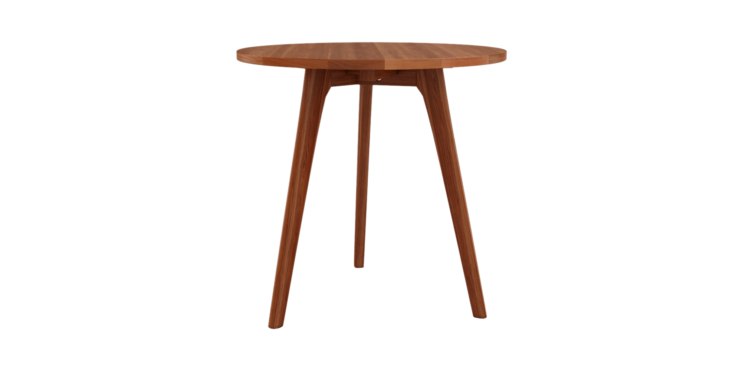
This is Bobby

Slide 16

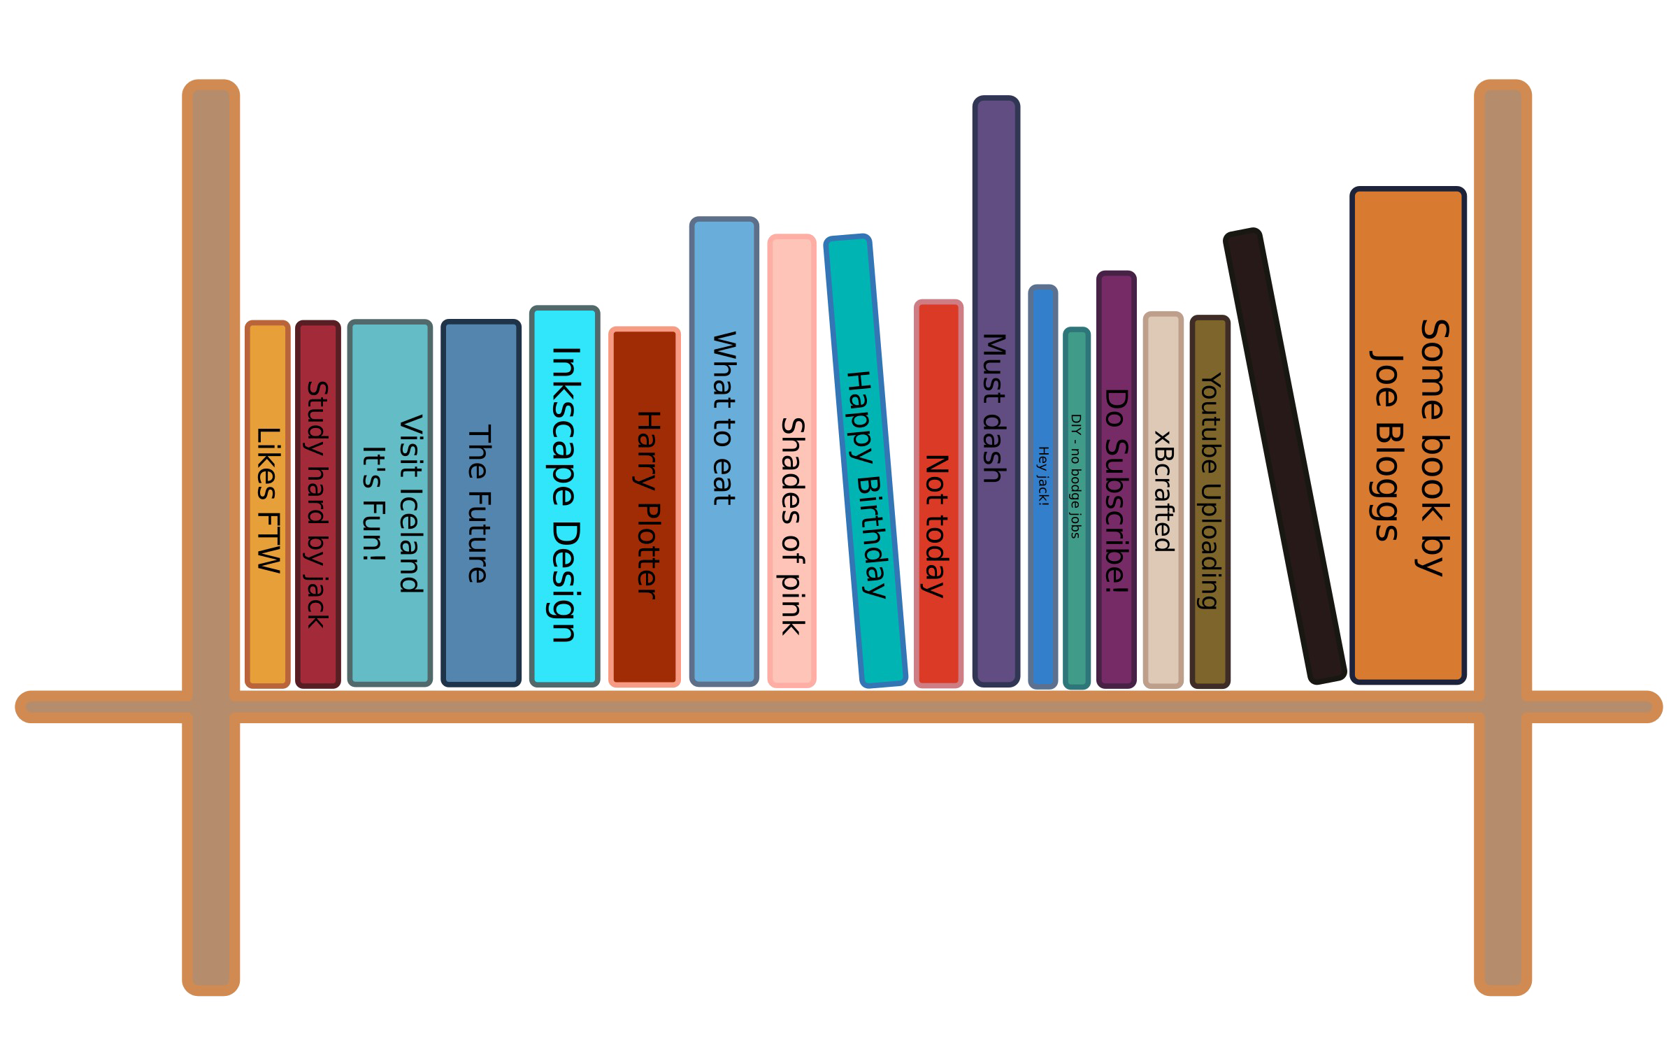


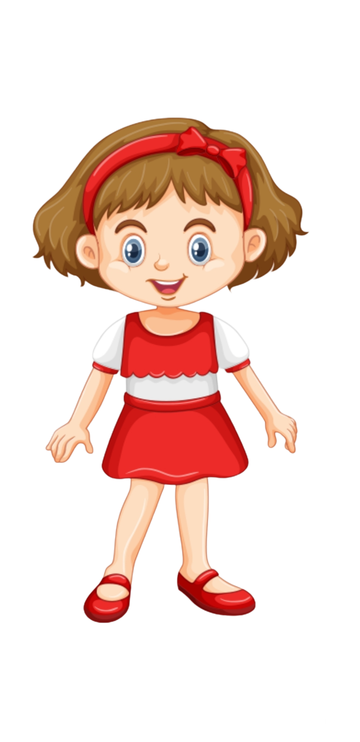

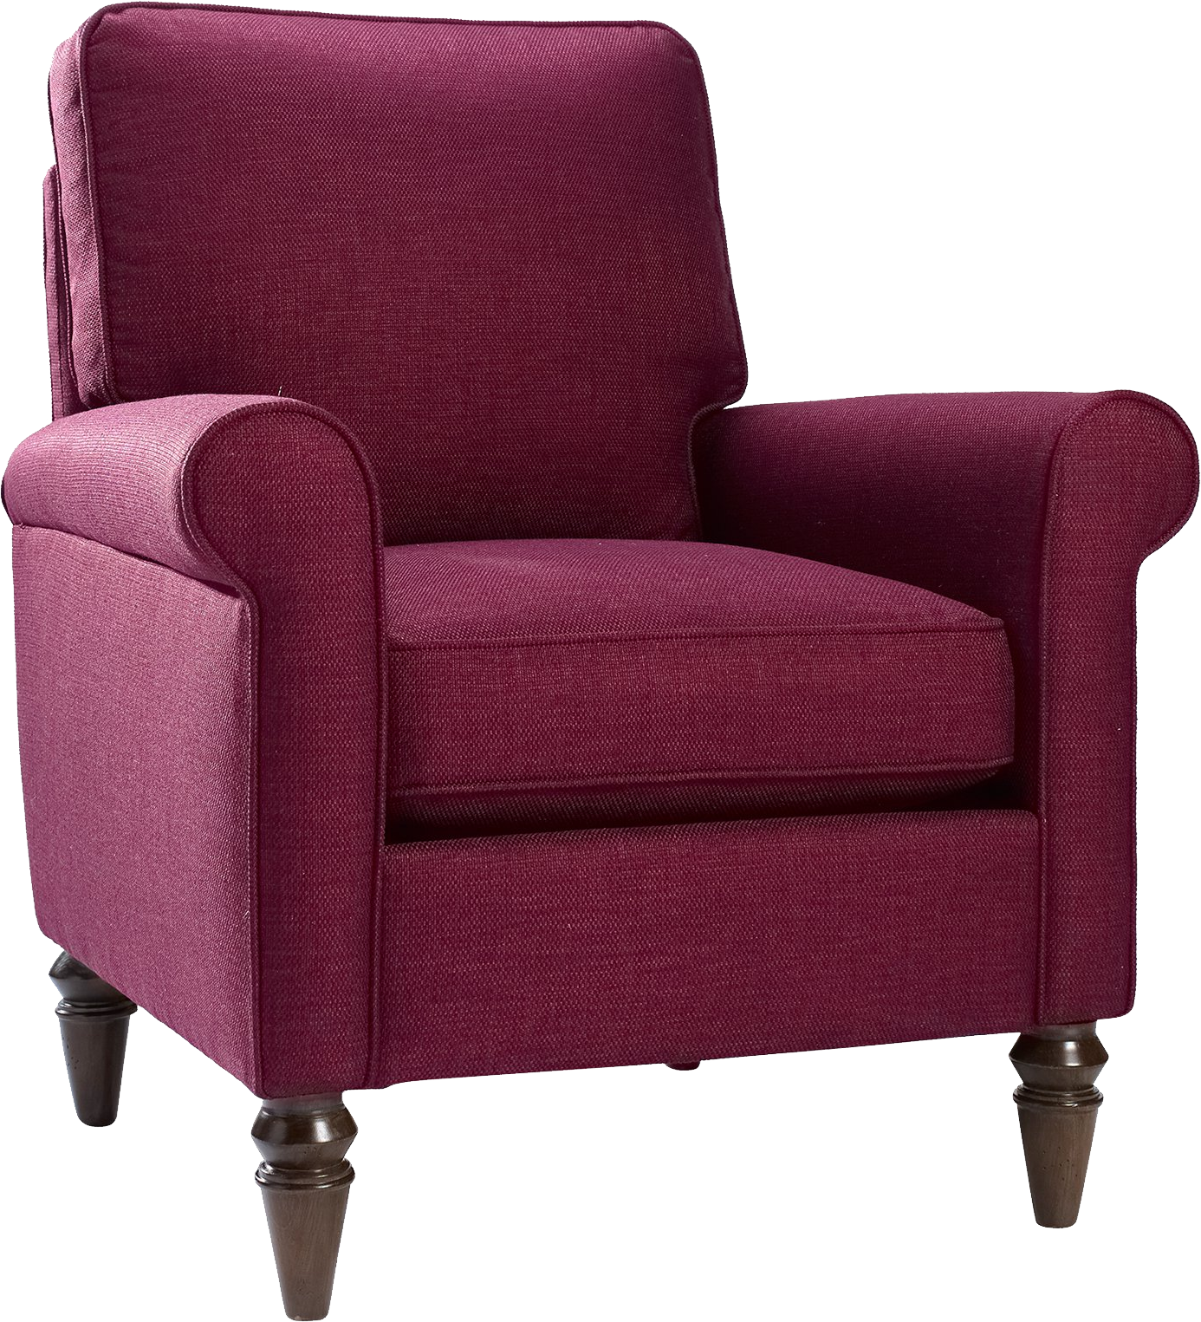
And this is Sophia

Slide 17
Sophia decides that she wants to scare Bobby

Slide 18
Sophia decides that she will hide behind the chair

Slide 19
Then she will call Bobby into the room and jump out to scare him!

Slide 20
Sophia goes to hide behind the chair.

Slide 21
See Sophia is hiding behind the chair.

Slide 22
Now she calls Bobby into the room

Slide 23
Bobby is now in the room

Slide 24
Sophia then jumps out and goes …

Slide 25
Boo!

Slide 26
Bobby falls into the mirror!

Slide 27
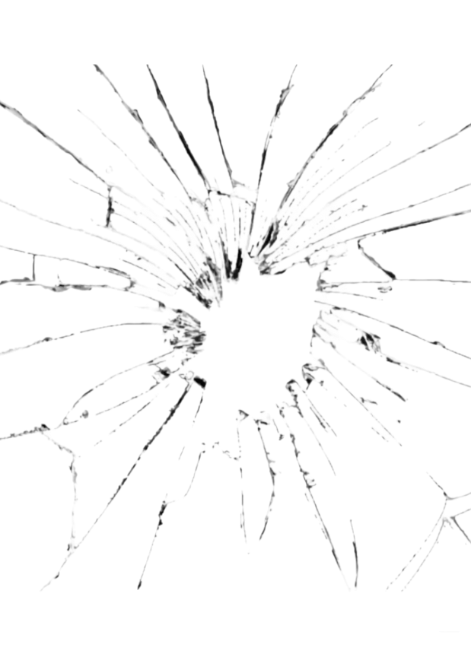
The mirror ended up cracking. See the mirror is cracked!

Slide 28
Luckily nobody got hurt—Bobby was OK.

Slide 29
Now that you saw what happened we would like to ask you a couple of questions

Slide 30
Who caused the mirror to crack?

Slide 31
Who cracked the mirror?

Slide 32
Whose fault is it that the mirror cracked?

Slide 33
Who should get in trouble for the cracked mirror?

Slide 34
Order 2

Slide 35
Break Case

Slide 36
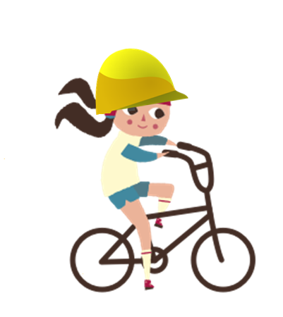
Here is Suzy. She is at the park riding her bike.

Slide 37

Here is Andy. He is at the park watching butterflies.

Slide 38

Suzy is riding her bike very fast and is coming around a corner.

Slide 39

As she comes around the corner, she ends up running right into Andy! Andy fell into the fence!

Slide 40



The fence ended up breaking! See the fence is broken!

Slide 41
Luckily nobody got hurt—Suzy and Andy were both OK.

Slide 42
Now that you saw what happened, we will ask you a couple of questions

Slide 43
Who caused the fence to break?

Slide 44
Who broke the fence?

Slide 45
Whose fault is it that the fence broke?

Slide 46
Who should get in trouble for the broken fence?

Slide 47
Crack Case

Slide 48
This is Sophia

Slide 49
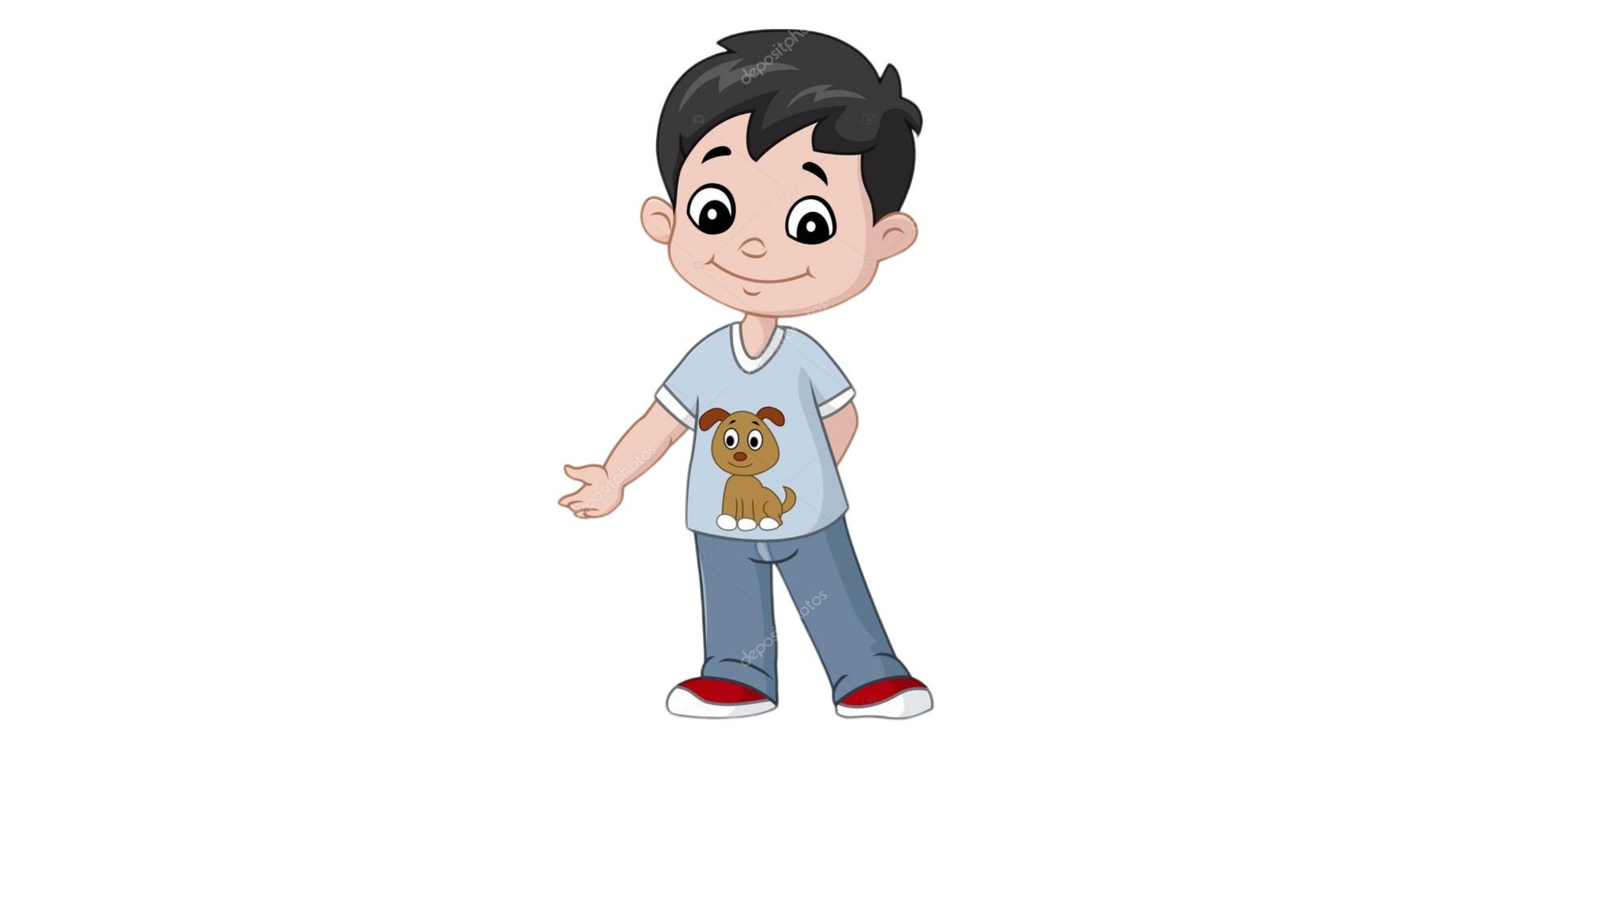
And this is Bobby

Slide 50
Bobby decides that he wants to scare Sophia

Slide 51
Bobby decides that he will hide behind the chair

Slide 52
Then he will call Sophia into the room and jump out to scare her!

Slide 53
Bobby goes to hide behind the chair.

Slide 54
See Bobby is hiding behind the chair.

Slide 55
Now he calls Sophia into the room

Slide 56
Sophia is now in the room

Slide 57
Bobby then jumps out and goes …

Slide 58
Boo!

Slide 59
Sophia falls into the mirror!

Slide 60
The mirror ended up cracking. See the mirror is cracked!

Slide 61
Luckily nobody got hurt—Sophia was OK.

Slide 62
Now that you saw what happened we would like to ask you a couple of questions

Slide 63
Who caused the mirror to crack?

Slide 64
Who cracked the mirror?

Slide 65
Whose fault is it that the mirror cracked?

Slide 66
Who should get in trouble for the cracked mirror?

